Slide 1

To PEG or not to PEG with Scala
MOIA Scala CoP, 26.01.2024 Mike Belikov

Slide 2
What is this talk about?
A bit parsing theory recap
PEGs with Parboiled2
Small demo
Links
Disclaimer
Notes:
Not an expert in this area at all
Not a complete overview / not up to date at all
Only practical aspect

Slide 3
Where are we?
A bit of parsing theory
PEGs with Parboiled2
Small demo
Links

Slide 4
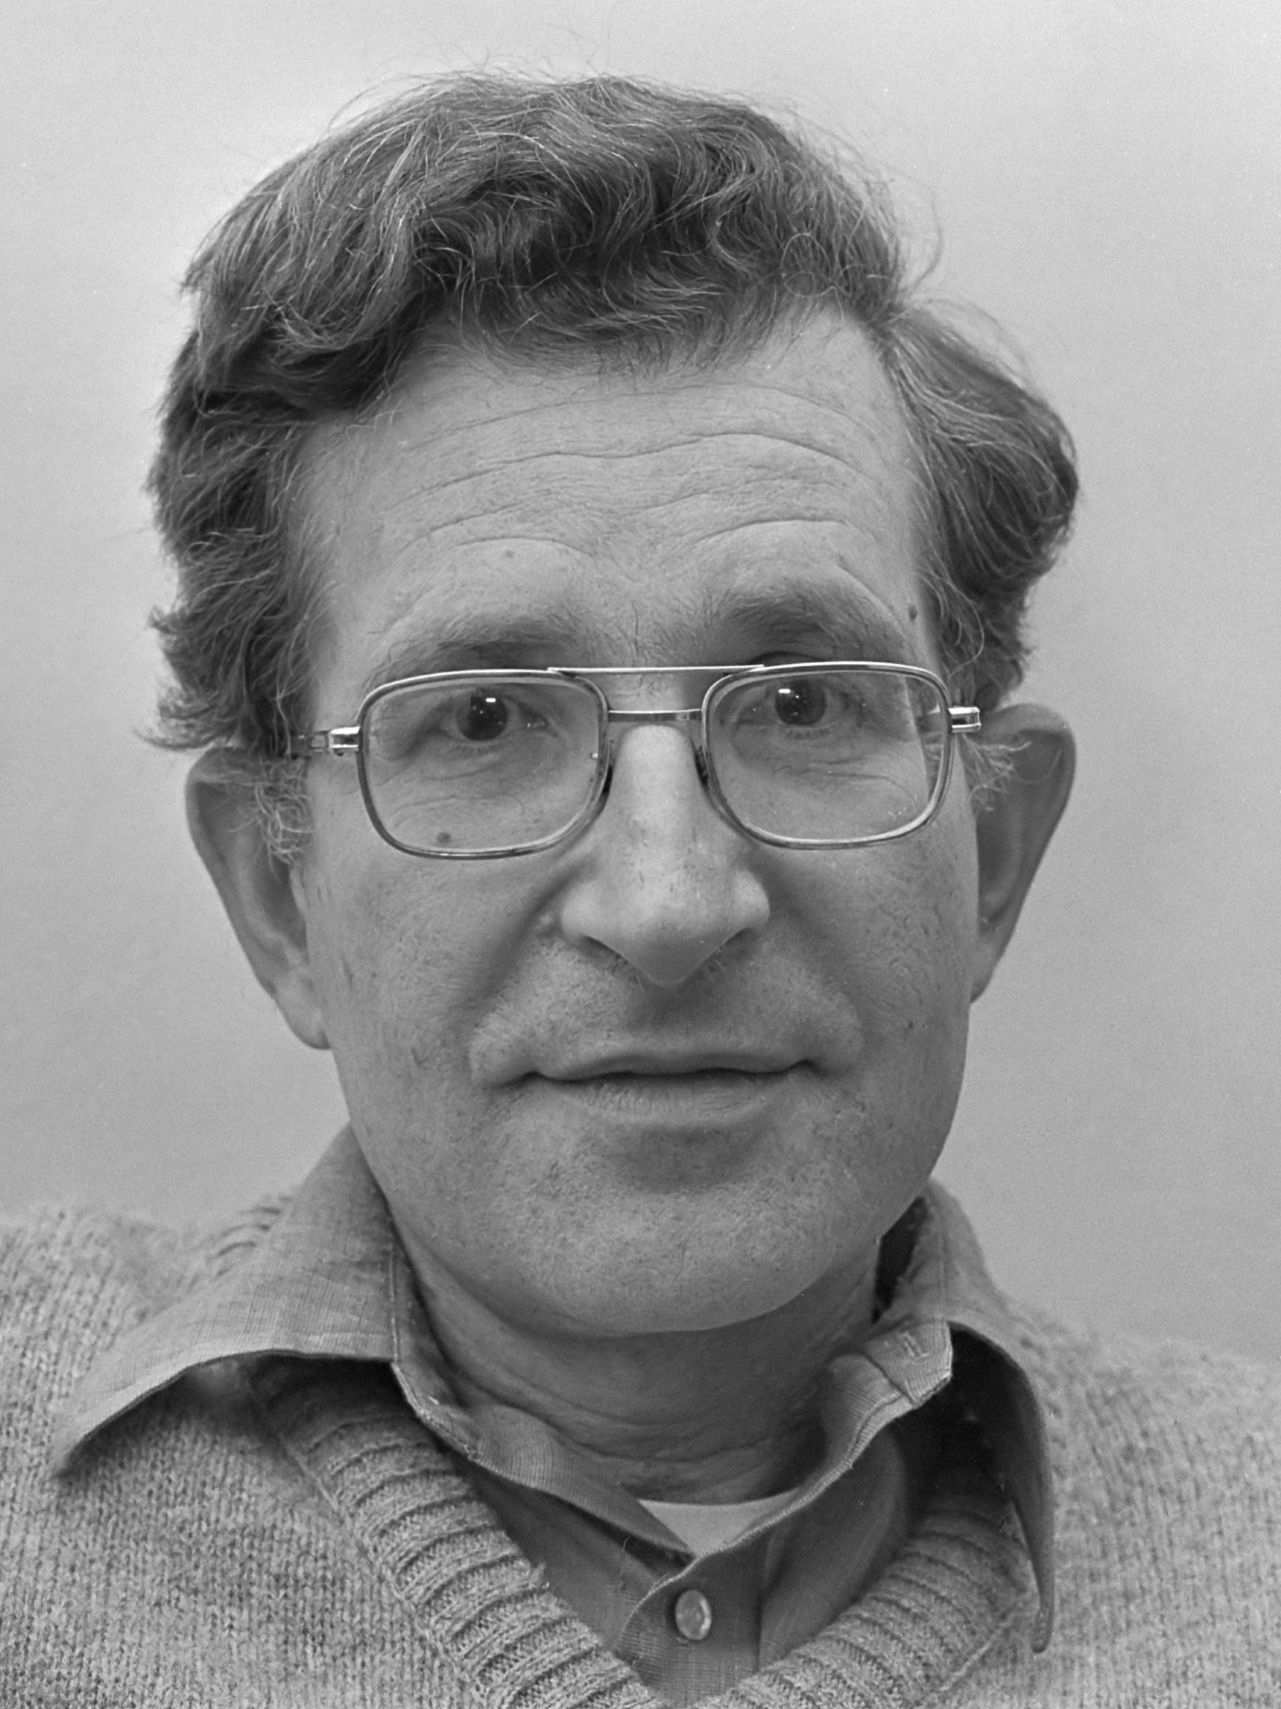

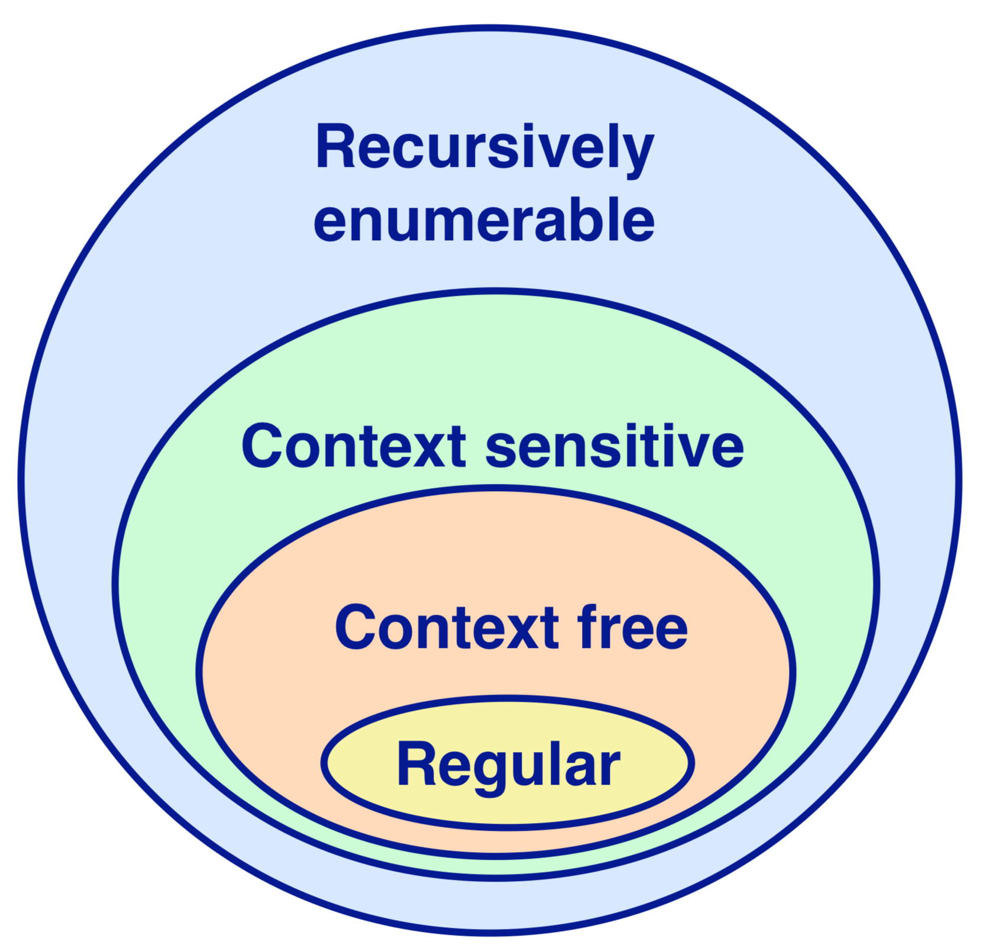


A bit of parsing theory
Happy Chomsky
What is a language?
Goo goo, daah daah!
わかりません!
We need a ‘valid’ language
Notes:
The method of human communication, either spoken or written, consisting of the use of words in a structured and conventional way.
The means of communication with machines often written in ASCII characters.

Slide 5
A bit of parsing theory
Why?
Building a new DSL or even a new language
Dealing with existing one

Slide 6
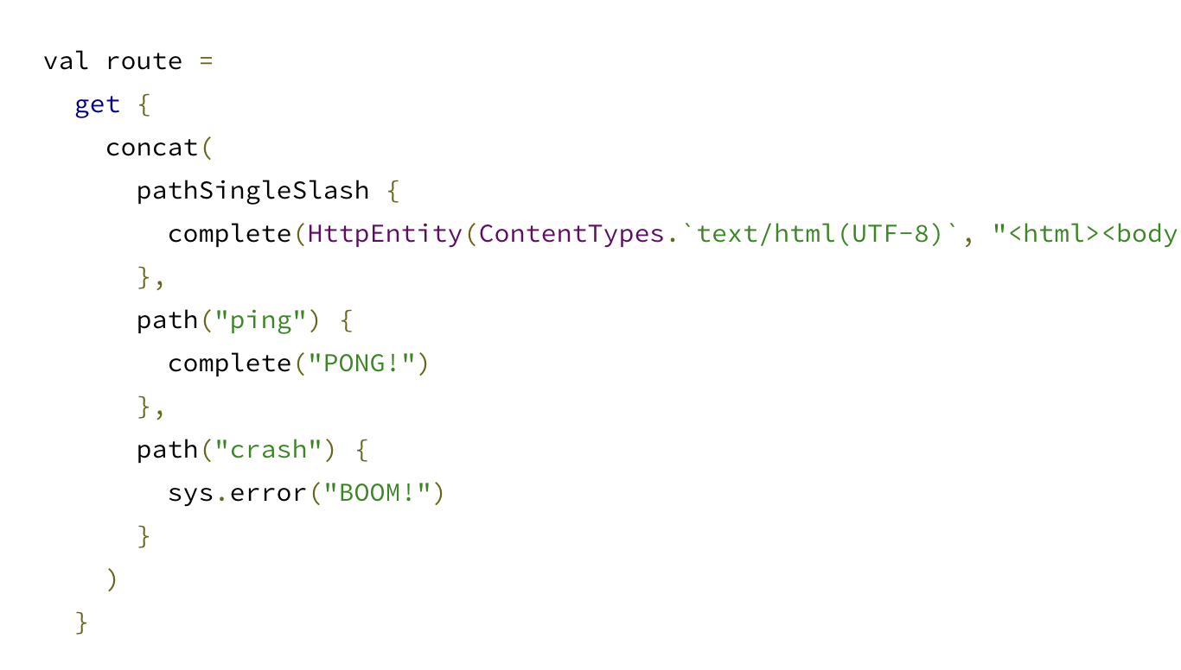
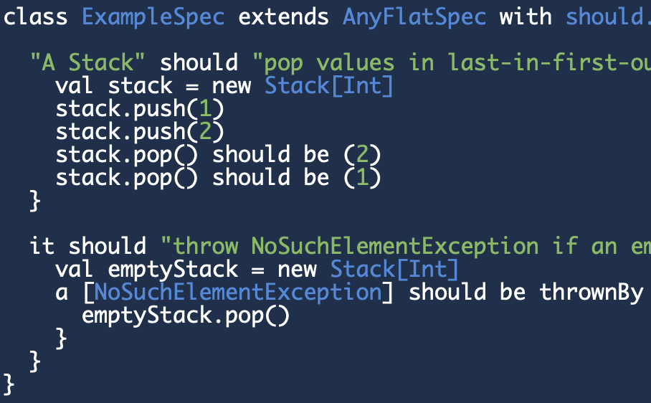
A bit of parsing theory
DSL
GPL vs DSL
external vs internal
https://martinfowler.com/bliki/DomainSpecificLanguage.html
markdown
SQL
yaml
CSS
HOCON

Slide 7
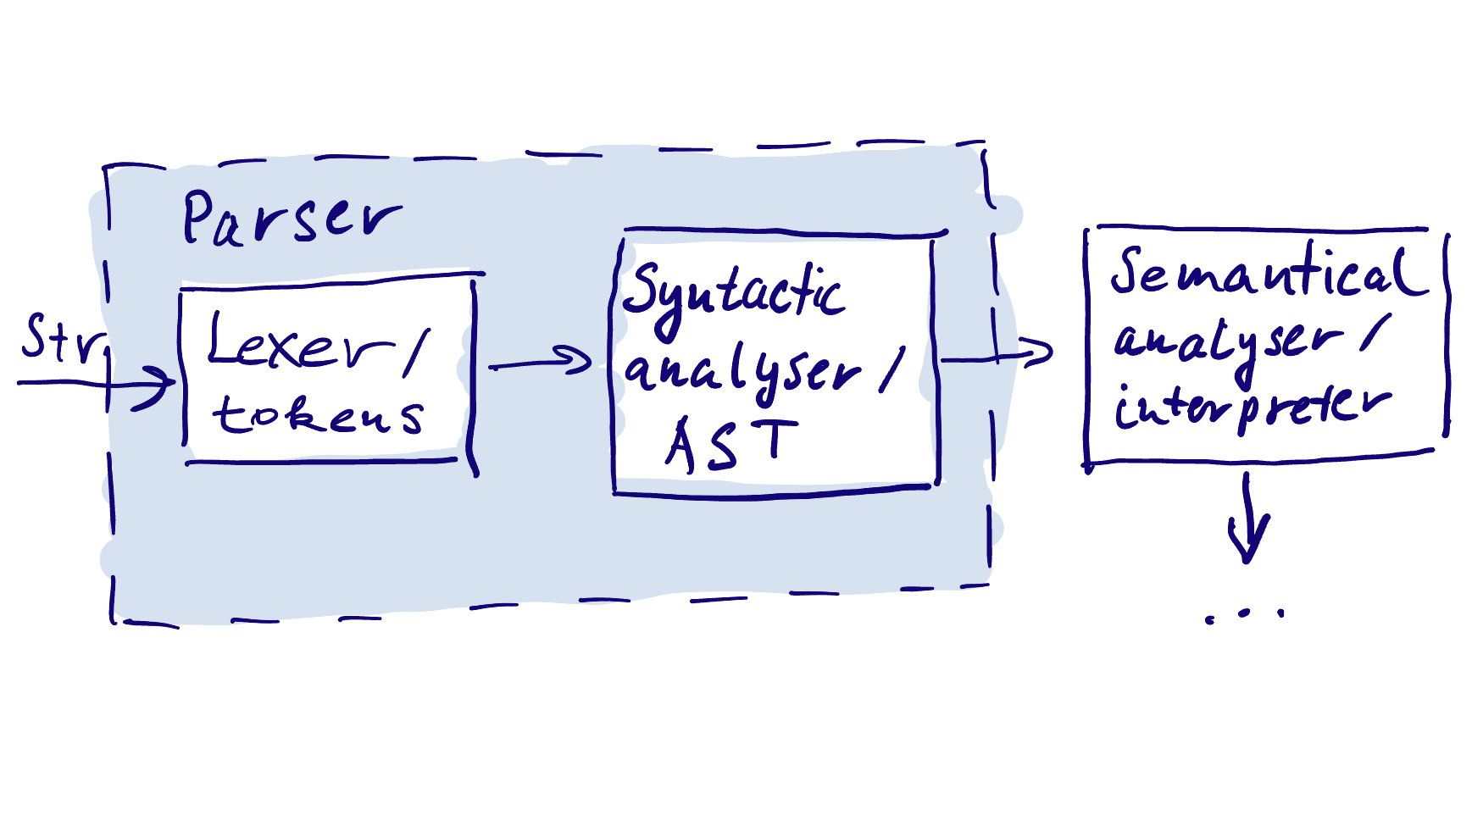
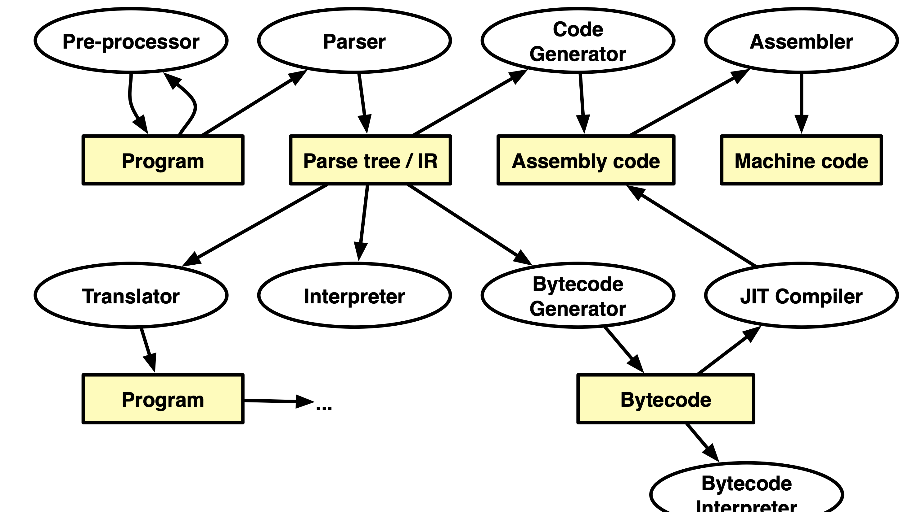

A bit of parsing theory
External DSL’s: Lexing vs Parsing vs Compiling vs Interpreting
Notes:
Lexer: •map characters to tokens •character string value for a token is a lexeme
•eliminate white space
Parser:
•construct IR(s) •produce meaningful error messages
•attempt error correction

Slide 8
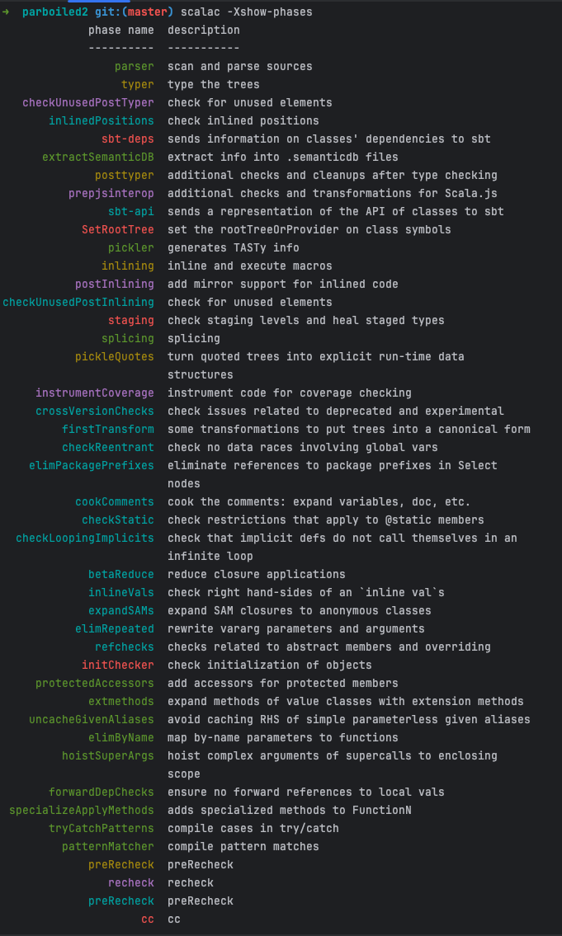
A bit of parsing theory
Scala compiler
https://typelevel.org/scala/docs/phases.html

Slide 9
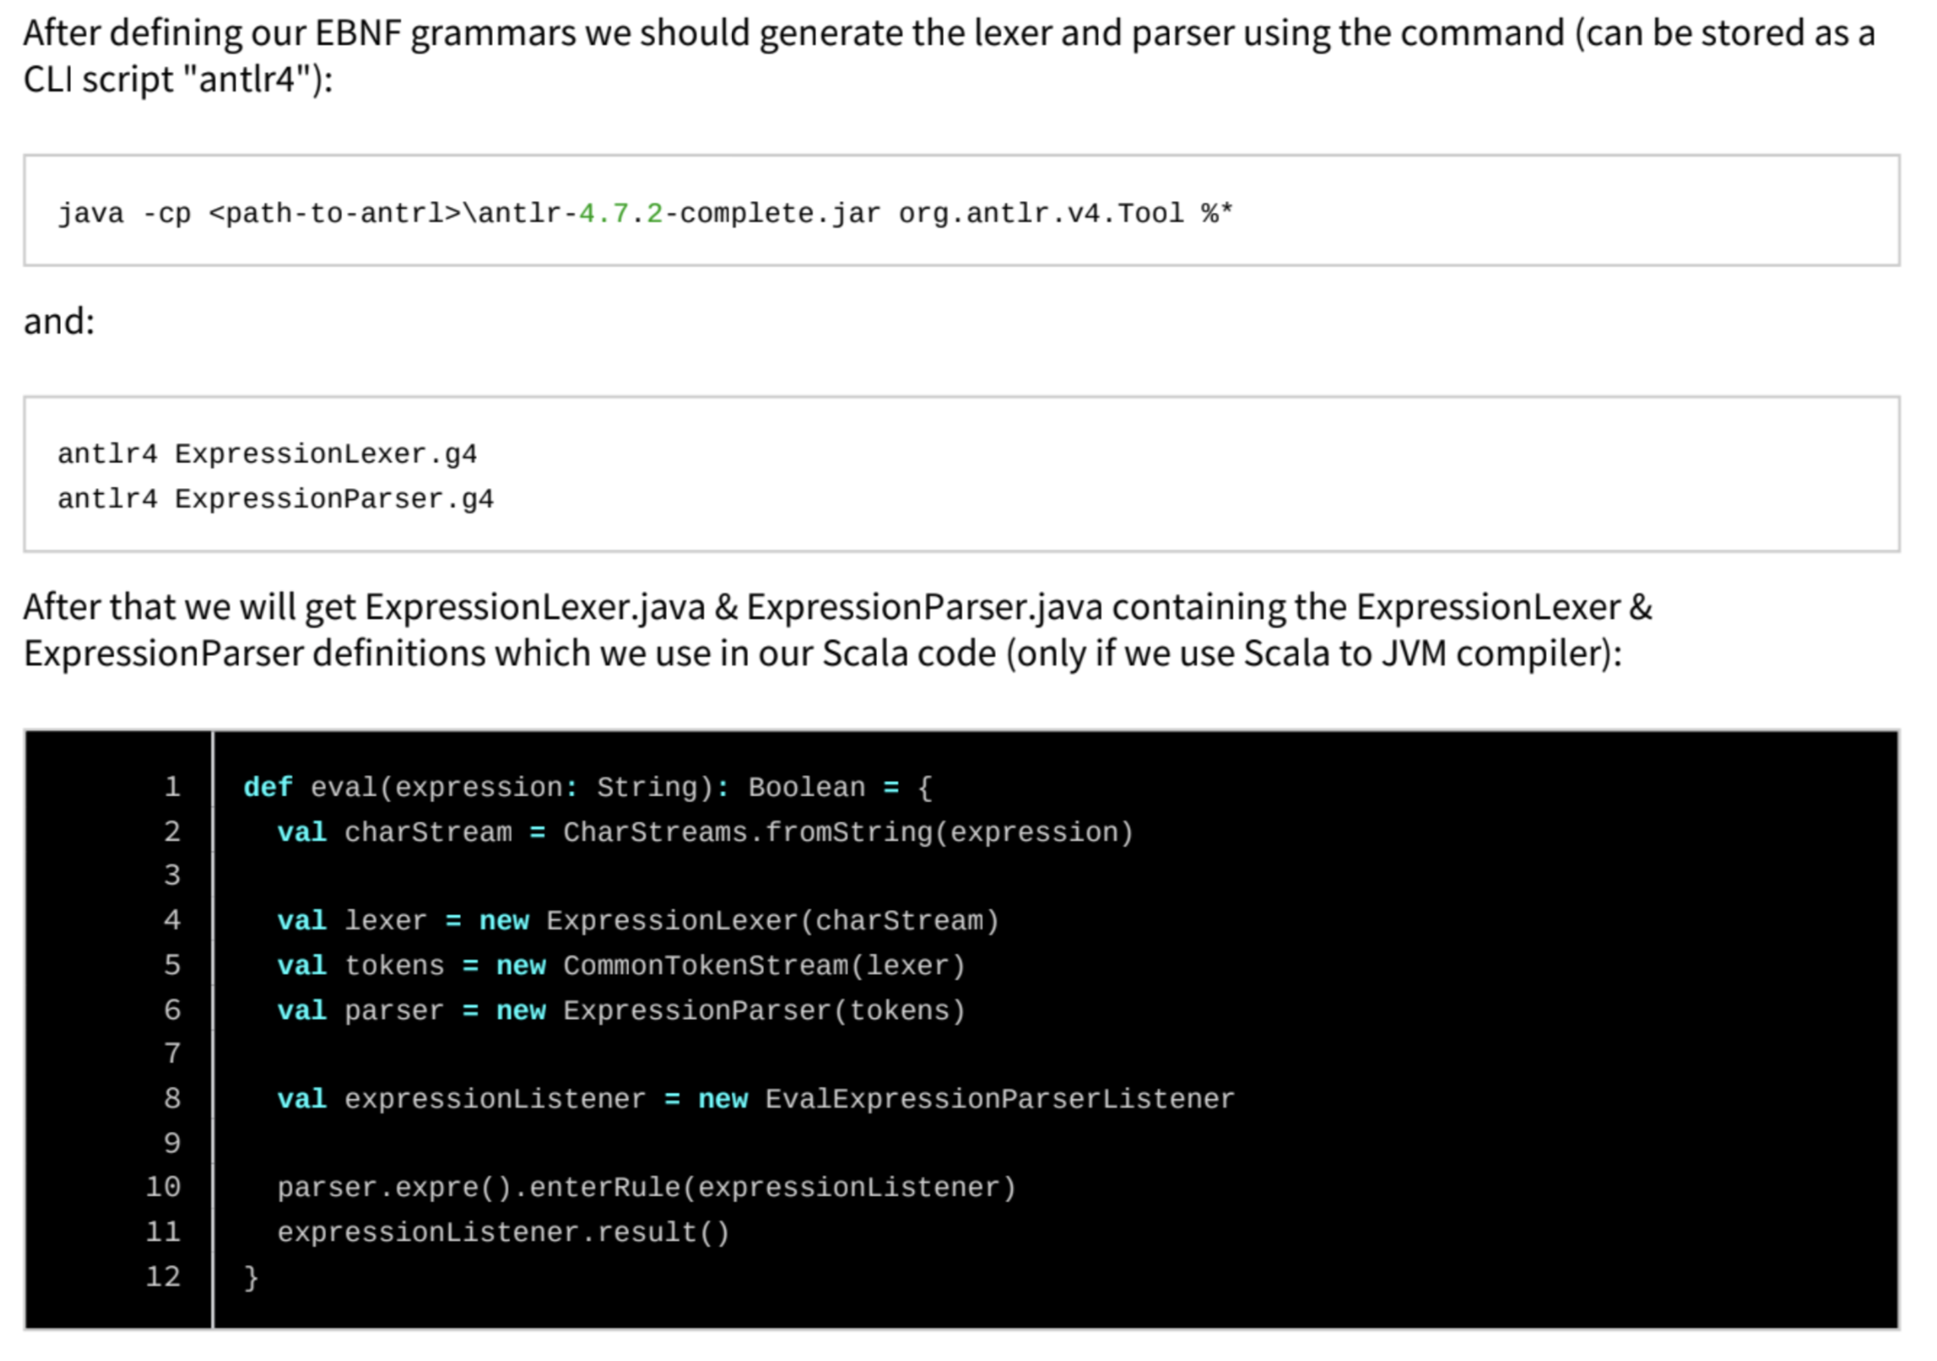
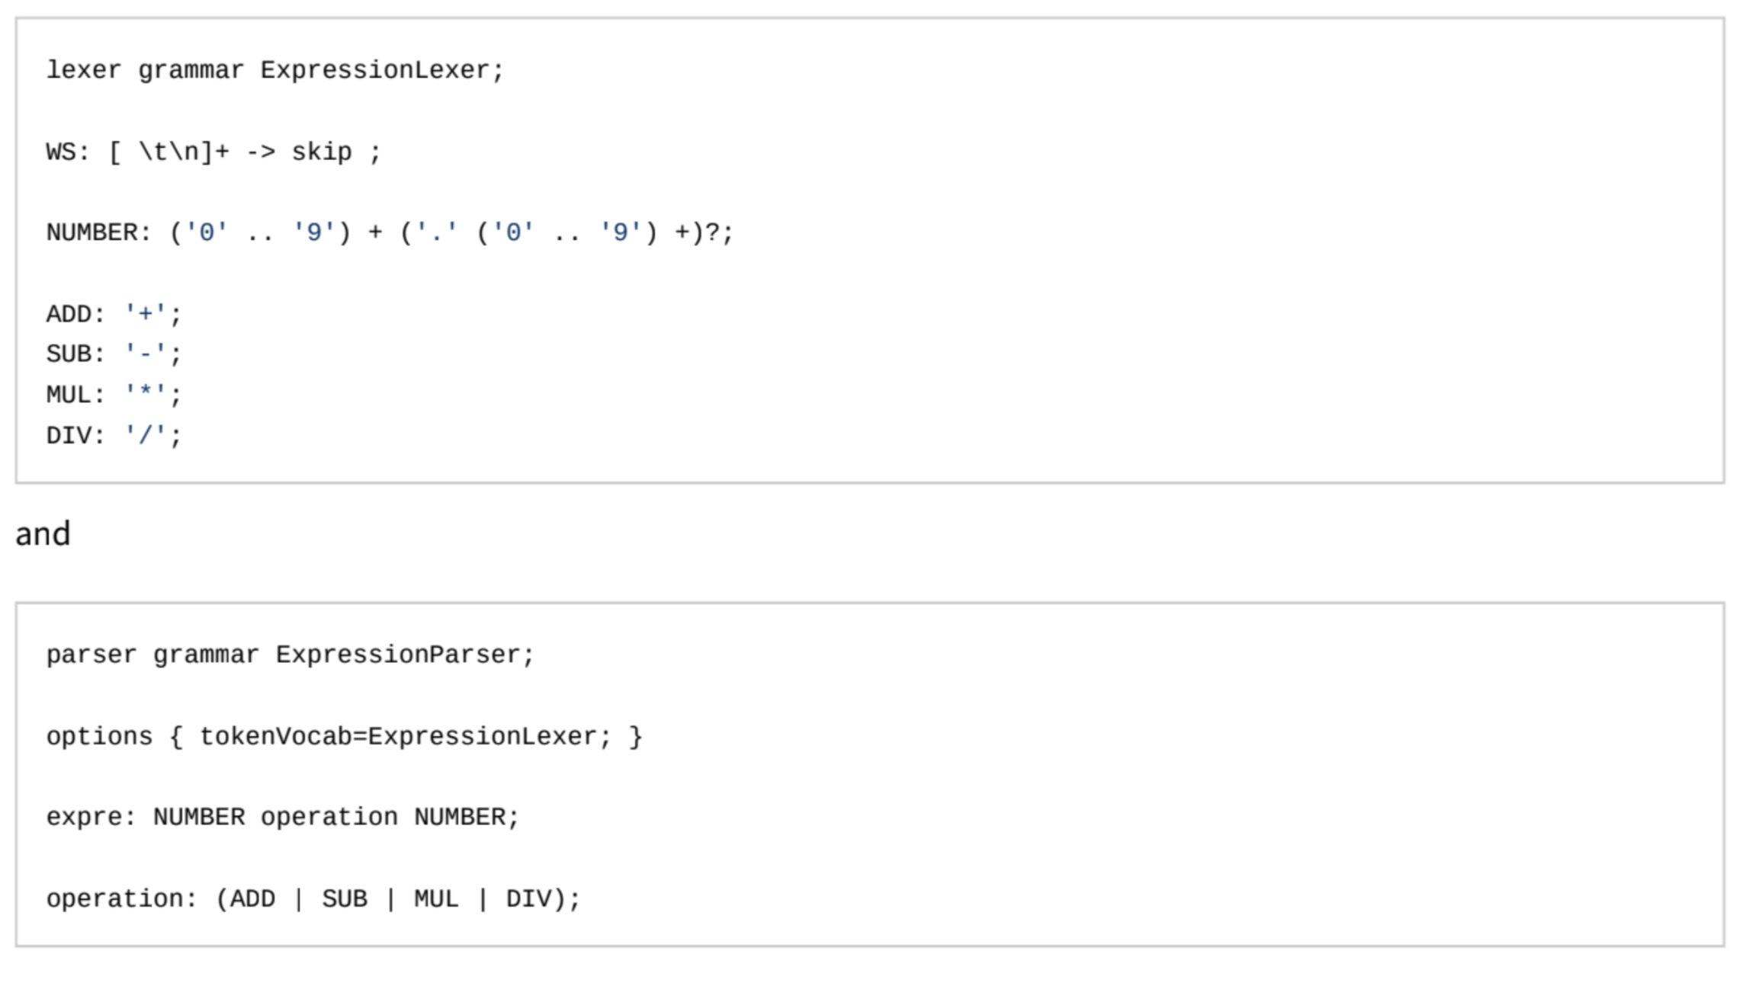
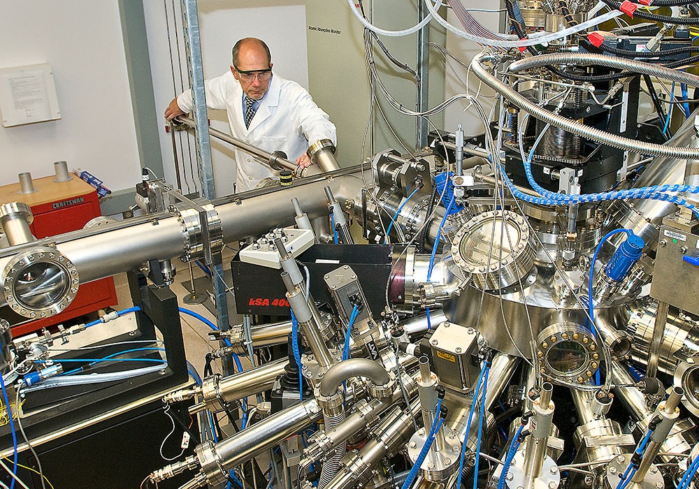
A bit of parsing theory
ANTLR?

Slide 10

A bit of parsing theory
Let’s PEG!
PEG = Parsing Expression Grammar
Bryan Ford, 2004: https://bford.info/pub/lang/peg/
PEG
Notes:
“Why do we cling to a generative mechanism for the description of our languages, from which we then laboriously derive recognizers, when almost all we ever do is recognizing text? Why don’t we specify our languages directly by a recognizer?”
Some people answer these two questions by “We shouldn’t” and “We should”, respectively.
— Grune & Jacobs, 2008
Similar to CFG

Slide 11
A bit of parsing theory
CFG vs RegExp vs PEG
EBNF vs PEG rules
Sad Chomsky
Arithmetic expression example
# A simplified PEG rule for parsing a basic arithmetic expression
Expression <- Term (( '+' / '-' ) Term)*
Term <- Factor (( '*' / '/' ) Factor)*
Factor <- Number / '(' Expression ')'
Number <- [0-9]+
S <- a^{n}b^{n}c^{n}
# A CFG for a basic arithmetic expression
<Expression> ::= <Term> { ("+" | "-") <Term> }
<Term> ::= <Factor> { ("*" | "/") <Factor> }
<Factor> ::= <Number> | "(" <Expression> ")"
<Number> ::= <Digit> { <Digit> }
<Digit> ::= "0" | "1" | "2" | "3" | "4" | "5" | "6" | "7" | "8" | "9"
Notes:
What exactly does a CFG describe?
Short answer: a rule system to generate language strings
What exactly do we want to describe?
Proposed answer: a rule system to recognize language strings
Unlike the CFG in the previous slide that generates sentences in a language, this PEG specifies rules to recognize sentences in a top- down fashion.

Slide 12
A bit of parsing theory
What is possible with PEGs?
Lexing + Parsing combination
DSL + GPL (even Scala) parsing
Could replace RegEx
Can express some non-context free languages (e.g. a^{n}b^{n}c^{n})
Playground https://com-lihaoyi.github.io/fastparse/

Slide 13
A bit of parsing theory
PEGs implementations
Python
parsimonious
JS
PEG.js, Chevrotain
Scala
parboiled2, Fastparse
Java
JavaPEG, parboiled
C++
PEGTL

Slide 14
Where are we?
A bit parsing theory recap
PEGs with Parboiled2
Small demo
Links

Slide 15
PEGs with Parboiled2
PEG abstract definition A PEG P=(Σ,N,R,eS)
Σ : a finite set of terminals (character set)
N : finite set of non-terminals
R : finite set of rules of the form “A ← e”, where A ∈ N, and e is a parsing expression
e_{S} : the start expression (a parsing expression)

Slide 16
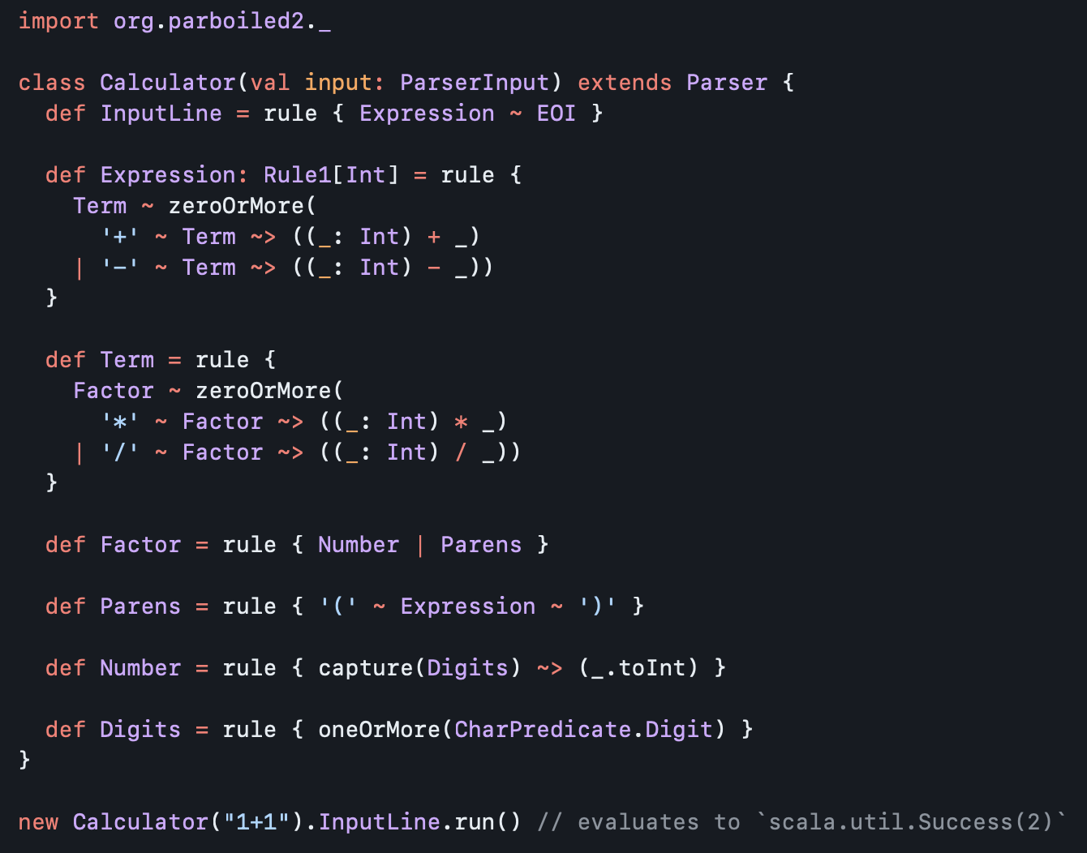
PEGs with Parboiled2
PEGs with Parboiled2
Rules don’t return anything directly
Rules can consume and can produce values for a ‘value stack’
Rules can be combined / modified:
Combo operator: ‘~‘
Ordered choice operator: ‘|’
…
Parser actions:
push(…), capture(…)
‘action’: ‘~>’
class Rule[-I <: HList, +O <: HList]
type Rule0 = RuleN[HNil]
type Rule1[+T] = RuleN[T :: HNil]
type Rule2[+A, +B] = RuleN[A :: B :: HNil]
type RuleN[+L <: HList] = Rule[HNil, L]
type PopRule[-L <: HList] = Rule[L, HNil]

Slide 17
PEGs with Parboiled2
State of Parboiled2
Supported Scala versions
2.12, 2.13, 3
JVM, JS, Native
Who is using
akka-http (URI, Header etc. parsers)
Sangria
Http4s (previously, replaced due to Dotty with cats-parse)
Cornichon
scala-uri (previously, replaced with cats-parse)
Gitlab
https://github.com/sirthias/parboiled2

Slide 18
PEGs with Parboiled2
Short overview
Direct Scala type-safe DSL
Good enough reporting of parse errors
Good parsing performance
Easy to understand and to start (1 day)
Light-weight (~ 900KB)
Doc: https://github.com/sirthias/parboiled2/blob/master/README_new.md

Slide 19
PEGs with Parboiled2
Alternatives
FastParse https://github.com/com-lihaoyi/fastparse
Cats-parse https://github.com/typelevel/cats-parse
Scala Parser Combinators https://github.com/scala/scala-parser-combinators

Slide 20
PEGs with Parboiled2
Examples
https://github.com/sirthias/parboiled2/tree/master/examples/src
https://github.com/akka/akka-http/blob/main/akka-http-core/src/main/scala/akka/http/impl/model/parser/UriParser.scala
https://github.com/sirthias/parboiled2/blob/master/scalaParser/src/main/scala/scalaparser/ScalaParser.scala

Slide 21
Could it be interesting now?
A bit parsing theory recap
PEGs with Parboiled2
Small demo
Links

Slide 22
Mini demo
Github https://github.com/mbelikov/pegtalk

Slide 23

Finally!
A bit parsing theory recap
PEGs with Parboiled2
Small demo
Links

Slide 24
References
Parsing Expression Grammars: A Recognition-Based Syntactic Foundation, Bryan Ford https://bford.info/pub/lang/peg/
parboiled2: a macro-based approach for effective generators of parsing expressions grammars in Scala, Alexander Myltsev https://arxiv.org/pdf/1907.03436.pdf
Compilers: Principles, Techniques, and Tools, Alfred V. Aho https://suif.stanford.edu/dragonbook/
Compiler Construction Slides, SCG University of Berne https://scg.unibe.ch/assets/download/lectures/cc/
https://en.wikipedia.org/wiki/Noam_Chomsky

